Slide 1
Lead acid batteries
Fyodor Malchik

Slide 2
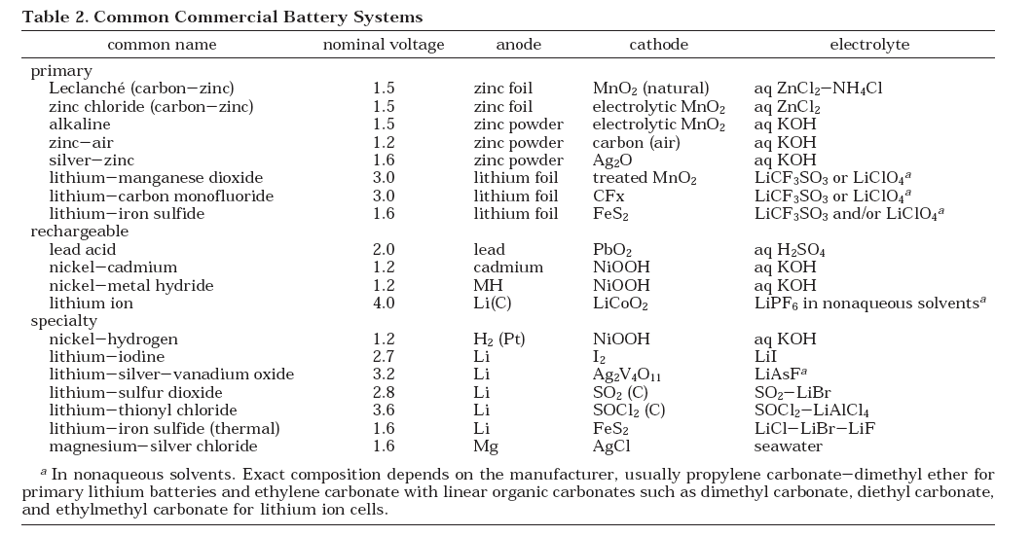
We will briefly look at: Lead and Lithium insertion
What are Batteries, Fuel Cells, and Supercapacitors, Chem Rev, 2004, 104, 4245, Martin Winter and Ralph J. Brodd

Slide 3
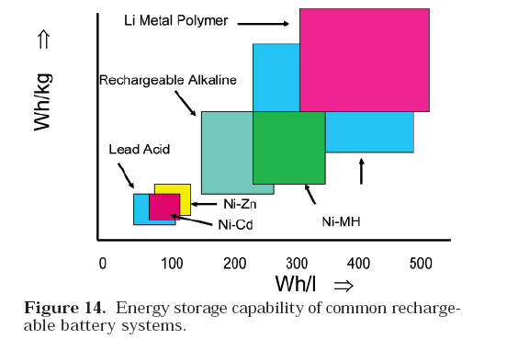
What are Batteries, Fuel Cells, and Supercapacitors, Chem Rev, 2004, 104, 4245, Martin Winter and Ralph J. Brodd

Slide 4
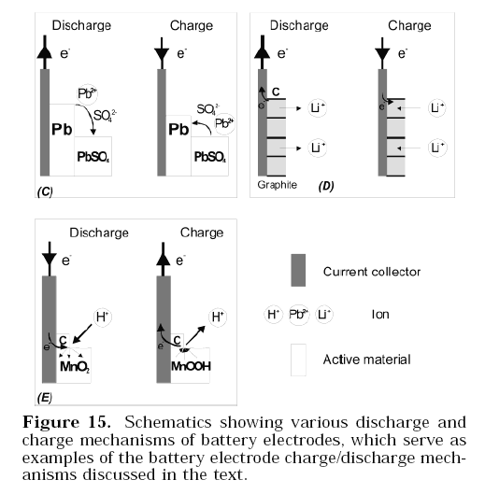
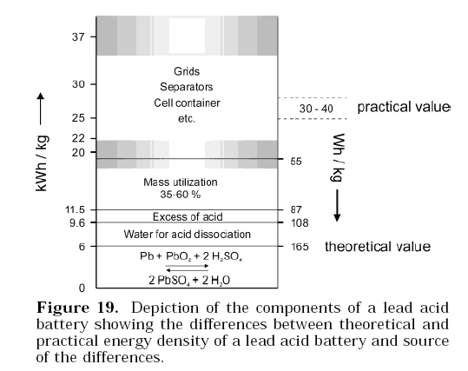
Require very good conductivity
Throughout the system
Which tends to lower the energy
Content of the system
In the lead acid system a significant amount
Of the weight Is in the grids required
To hold the paste
What are Batteries, Fuel Cells, and Supercapacitors, Chem Rev, 2004, 104, 4245, Martin Winter and Ralph J. Brodd

Slide 5
The capacity of the battery depends on
The type of material present.
Fitch lead book
Support grids

Slide 6
One possible mechanism:. simultaneous dissolution of PbO2 and introduction of 2e
Requires electronic conductivity of PbO2 and pore space for motion of water
Add e, H+ and OH- to PbO2
Add 2nd e to reduce valence of Pb
Add 3rd e to reduce valence while removing OH- for charge nuetrality
PbO is more soluble than PbO2 so it dissolves and reacts with sulfate to
Initiate formation of PbSO4, nucleation rate rises with lg conc. Sulfate, which reduces growth of large sized crystals
PbSO4 structure is rhombic which matches the PbO2 so it can easily attach
Therefore need to control the alletropes of PbO2 and PbO

Slide 7
Beta PbO2 is formed under acid and can be compressed to shorten bonds
overlap induces semiconductor behavior which increases the performance
Of the battery
Add antiomony
To drive reaction
To beta phase
Alpha forms when Pb metal
Corrodes – reduces lifetime of
Battery, is more compressible.

Slide 8
Lead Acid battery
a.What is the potential associated with a lead
acid battery with the overall reaction:
at the following concentration:
[H₂SO₄] = 4.5 M

Slide 9
Vº
1.69
-0.35
1.69
-(-0.35)
2.04

Slide 10
Lead Acid battery energy

Slide 11
c. What is the free energy associated with the lead acid battery?

Slide 12
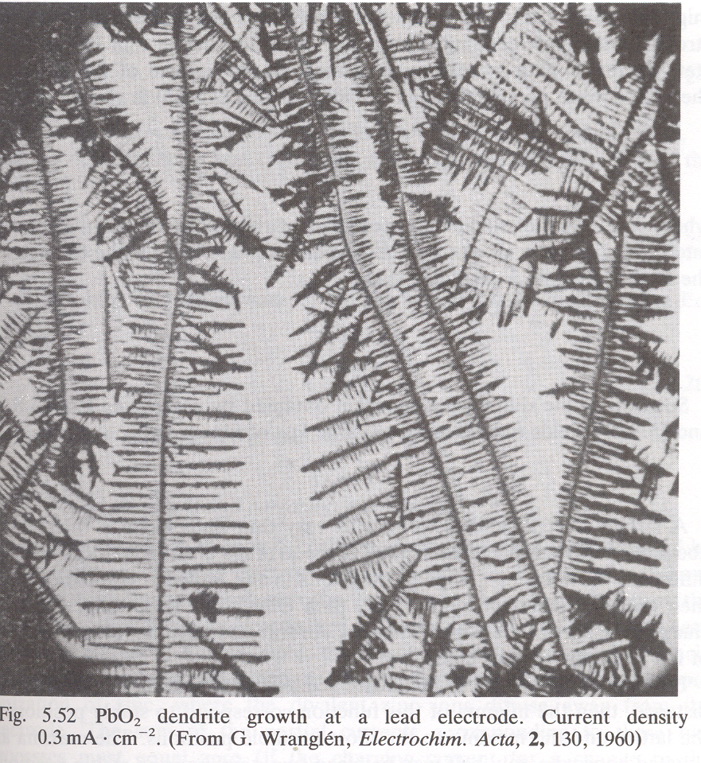
Dendrites are
Good: porous (makes more
Of possible energy available)
Bad: fragile, break and fall
from underlying electrode
= NO CURRENT
e
No e

Slide 13
The type of structure that forms depends upon the rate of crystallization which
Depends upon rate of reaction which depends upon:
Loss/production of products (current)
Which depends also upon the rate constant (potential dependent)

Slide 14
One way to “image” the various processes described above is by an
Equivalent Circuit

Slide 15
In a simplified system
As the battery is discharged the discharge voltage is the
Difference between what we started with and the remaining
Voltage in the battery

Slide 16
Lead acid batteries can be valve regulated to control the pressure associated
With
No pressure
1.29 V
1.38 V
Suggests higher
Degree of interparticle
Contact under pressure
Lower CT resistance
Under pressure
pressurized

Slide 17
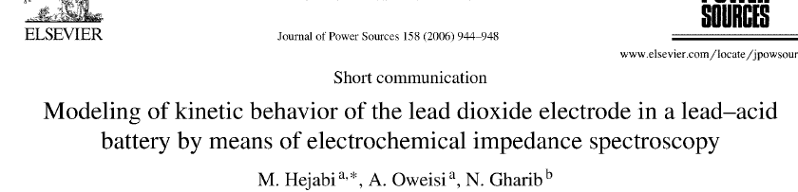

Insulating layer which can conduct only protons and lead
Solubility
Diffusion
Et at conducting PbO2

Slide 18
Solubility
Diffusion
Et at conducting PbO2
Modeled effect of diffusion

Slide 19
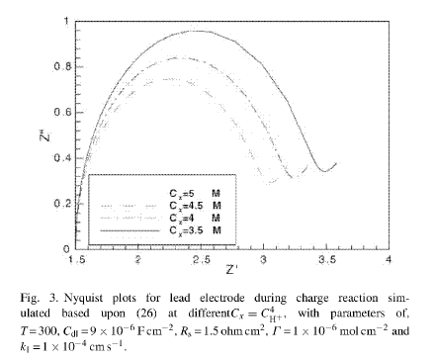
Solubility
Diffusion
Et at conducting PbO2
Modeled effect of proton conc

Slide 20
Solubility
Diffusion
Et at conducting PbO2
Different magnitude of discharge
Changes the solubility and proton conc
As well as the conductivity of the film

Slide 22
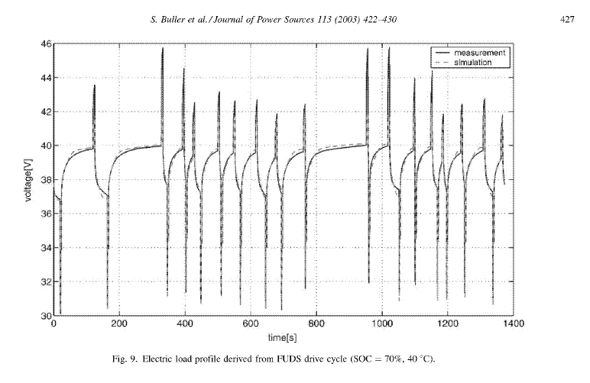

Slide 23
Based on V. S. Bagotsky text, Fundamentals of Electrochemistry

Slide 24
For the simplified model

Slide 25
Monitor structural changes at electrode as a function of the discharge power

Slide 26
Charge transfer resistance
Decreases due formation of more porous PbO2
Small diameter
Of impedance
Circle here indicates
The fast et kinetics of
O2 reaction.
High charge transfer
Resistance due to insulating
PbSO4 layer
Increasing
Charge transfer
Resistance due
To layer of PbSO4

Slide 27
Reaction Vº
Li⁺+e Li -3.0
K⁺ + e K -2.95
Na⁺ + e Na -2.71
NCl₃_4H⁺ + 6e 3Cl⁻ + NH₄⁺ -1.37
2H₂O + 2e H₂ + 2OH⁻ -0.828
Fe²⁺ + 2e Fe -0.44
Pb²⁺ + 2e Pb -0.13
2H⁺ + 2e H_{2(gas)} 0
N₂(g) + 8H⁺ + 6e 2NH₄⁺ 0.275
Cu²⁺ + 2e Cu 0.34
O₂ + 2H₂O + 4e 4OH⁻ 0.40
O₂ + 2H⁺ + 2e H₂O₂ 0.68
Ag⁺ + e Ag 0.799
NO₃⁻ + 4H⁺ + 3e NO(g) +2H₂O 0.957
Br₂ + 2e 2Br⁻ 1.09
2NO₃⁻ + 12H⁺ + 10e N₂(g) +6H₂O 1.246
Cl₂ ⁺ 2e 2Cl⁻ 1.36
Au⁺ + e Au 1.83
F₂ + 2e 2F⁻ 2.87
7g/mol
207g/mol

Slide 28
